Slide 1
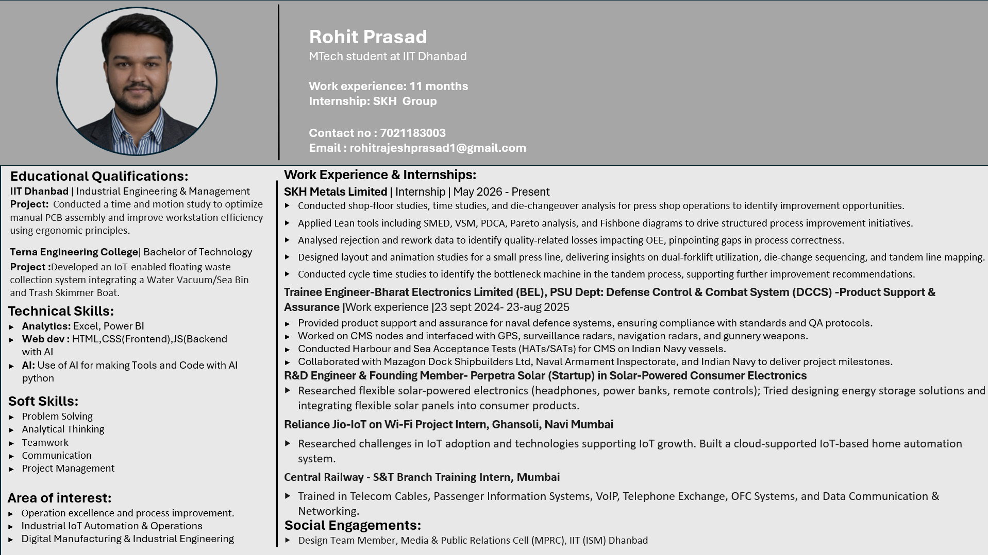

Resume
Innovation & Excellence I Customer Delight I Ownership I Respect, Fairness & Transparency
1

Slide 2








My understanding about SKH
Vision:
A Technology agnostic solutions provider in the mobility space driven by sustainability powered by our people and driven by their well being
Technology
Mobility
Sustainability
People Well-being
Core Values:
Innovation & Excellence
Customer Delight
Ownership
Respect, Fairness & Transparency
Innovation & Excellence I Customer Delight I Ownership I Respect, Fairness & Transparency
2

Slide 3
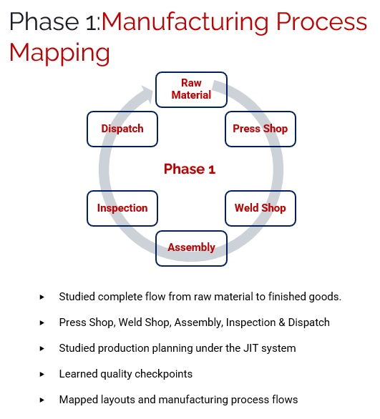
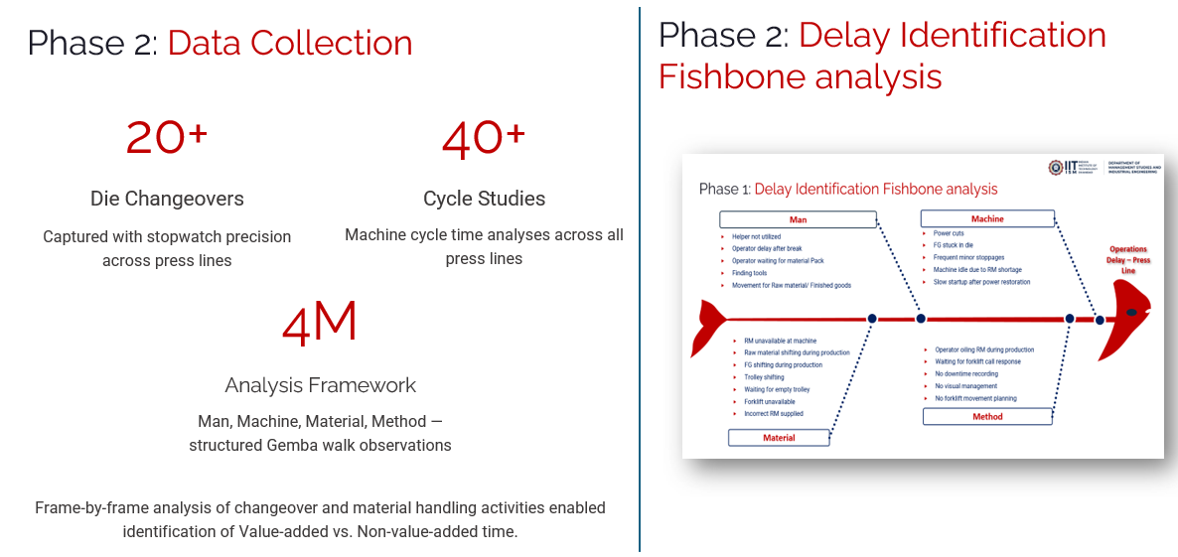
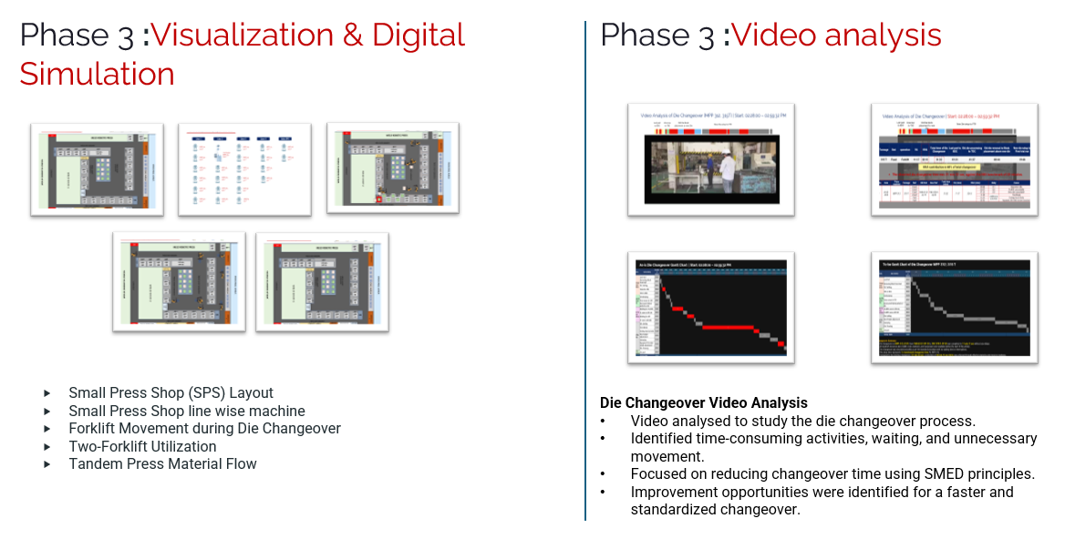
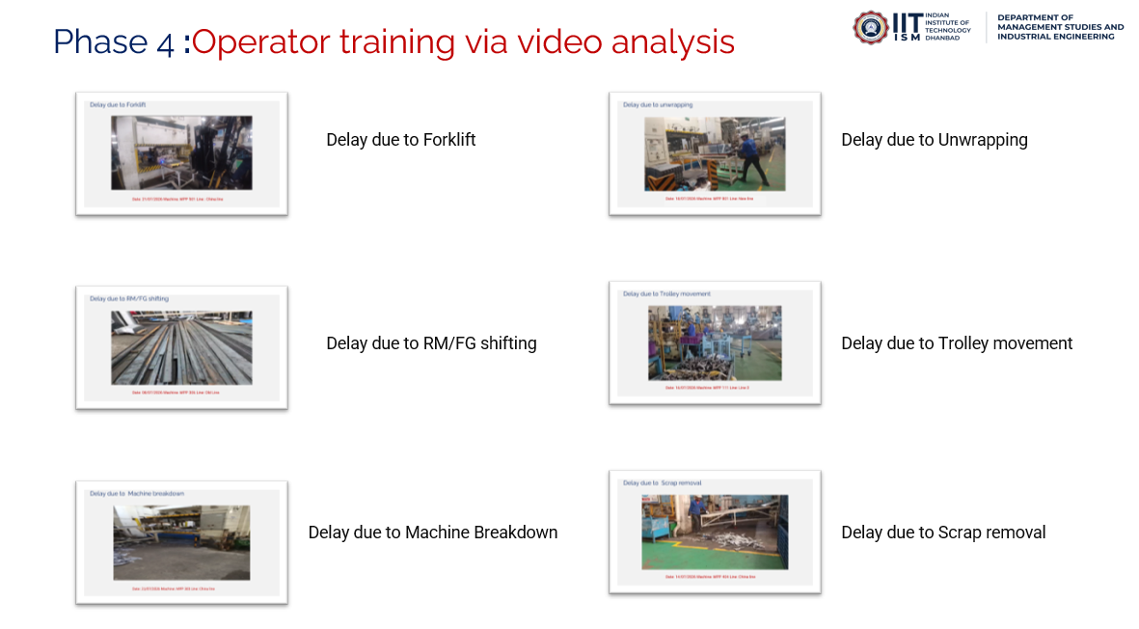
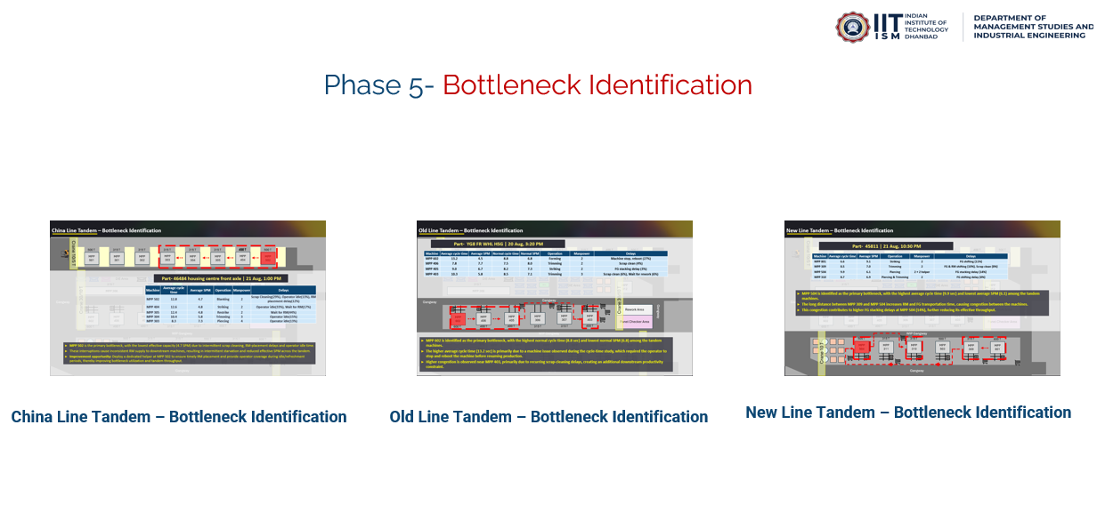
Overall Internship Exposure | Key Assignments & Deliverables
Onboarding
Understood shop-floor operations & study requirements
Key Parameters
Understood CT, Die Changeover & OEE
Shop-floor Studies
Conducted CT & Die Change studies and collected data
Improvement Identification
Identified delays, losses & productivity opportunities
SKH Manesar
1
Understand &Diagnose
Plant mapping, process observation, data collection
2
Analyze
Time study, Root cause analysis
3
Visualize & Design
Layout simulation, standard work, opportunity design, video analysis
4
Deliver
operator training Video analysis for improvement purpose
5
Additional analysis
Bottleneck identification of M/C
& Rework and Rejection analysis
SKH Binola
Observe
Understood plant operations, process flow and study requirements
Evaluate
Analysed cycle times paint shop, wagon delays, VA/NVA activities, and manpower utilization.
Action
Performed detailed time studies and developed digital simulation models.
SKH Pune
Innovation & Excellence I Customer Delight I Ownership I Respect, Fairness & Transparency
3

Slide 4
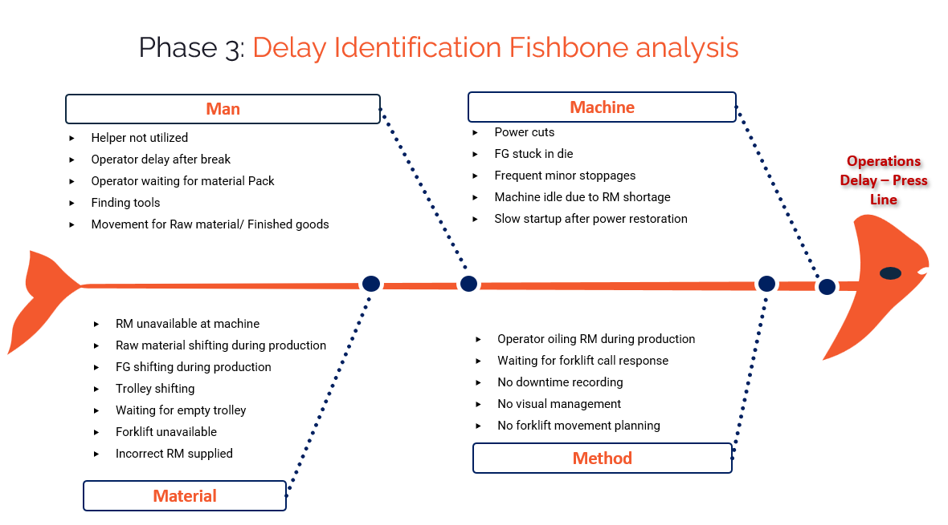
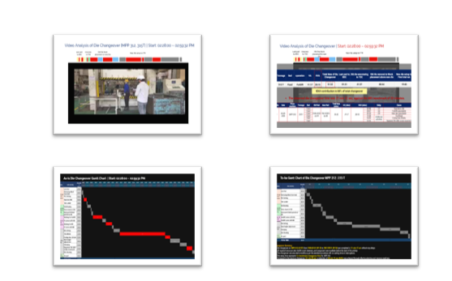
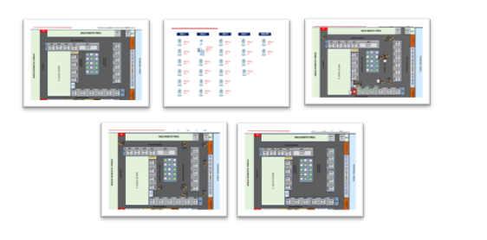
Overall Internship Exposure (SKH Binola) | Key Assignments & Deliverables
Phase 1:Manufacturing Process Mapping
Process Improvement Roadmap
Phase 1
Understand &Diagnose
Phase 2
Analyze
Phase 3
Visualize & Design
Phase 4
Deliver
Plant mapping, process observation, data collection
Time study, video analysis, root cause analysis
Layout simulation, standard work, opportunity design
PMO tracking, implementation, operator training
Phase 5
Sustain
SOPs, monitoring, continuous improvement
Press Shop
Inspection
Dispatch
Weld Shop
Raw Material
Studied complete flow from raw material to finished goods.
Press Shop, Weld Shop, Assembly , paint shop, Inspection & Dispatch
Studied production planning under the JIT system
Learned quality checkpoints
Mapped layouts and manufacturing process flows
Phase 2:Data collection
Phase 3:Delay Identification Fishbone analysis
20+
40+
4M
Observed press-line delays and grouped their causes under Man, Machine, Material, and Method.
Die Changeovers
Cycle Studies
Analysis Framework
Operator waiting and tool search delays
Machine stoppages , power cuts and die jams
Material movement delays
Forklift and trolley availability issues
Gaps in downtime recording and visual management
Captured with stopwatch precision across press lines
Machine cycle time analyses across all press lines
Man, Machine, Material, Method structured Gemba walk observations
Frame-by-frame analysis of changeover and material handling activities enabled identification of Value-added vs. Non-value-added time.
Phase 3:Visualization & Digital Simulation
Phase 4:Visualization & Digital Simulation
Video analyzed to study the die changeover process
Identified time - consuming activities, waiting and unnecessary movement
Focused on reducing changeover time using SMED principles
Improvement opportunities were identified for a faster and standardized changeovers
Small Press Shop (SPS) Layout
Small Press Shop line wise machine
Forklift Movement during Die Changeover
Two-Forklift Utilization
Tandem Press Material Flow
Innovation & Excellence I Customer Delight I Ownership I Respect, Fairness & Transparency
4

Slide 5
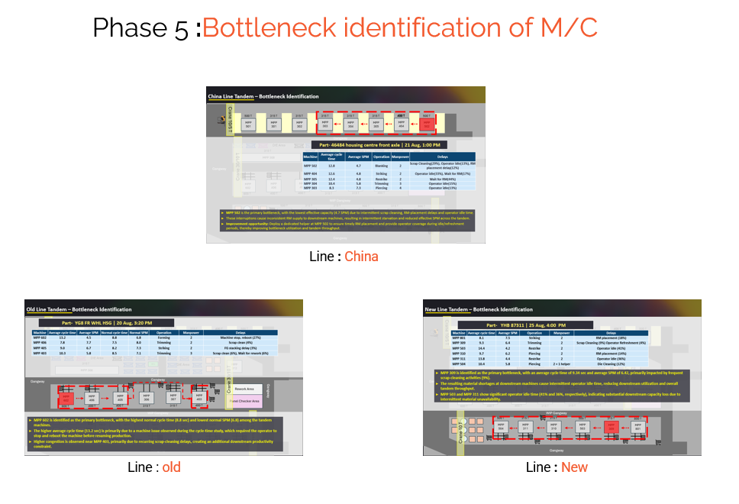
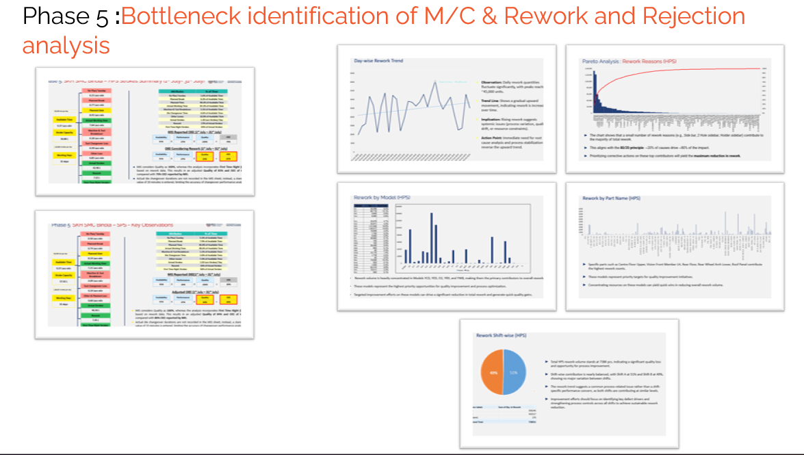
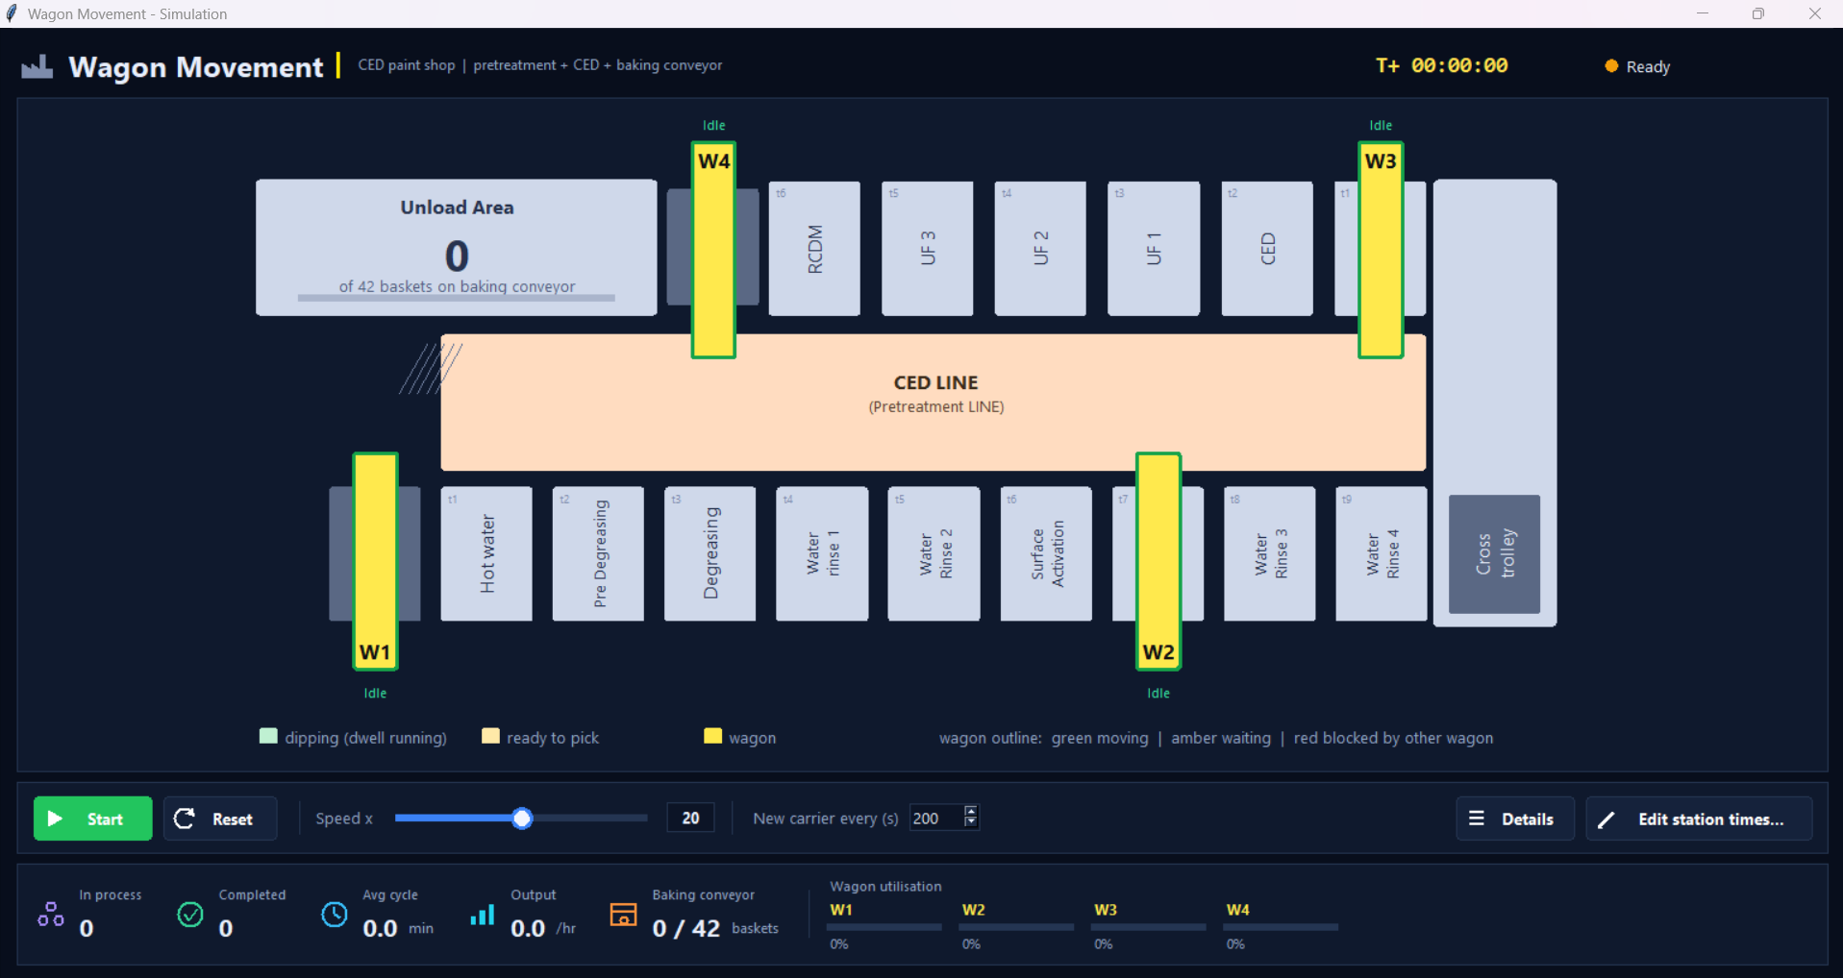
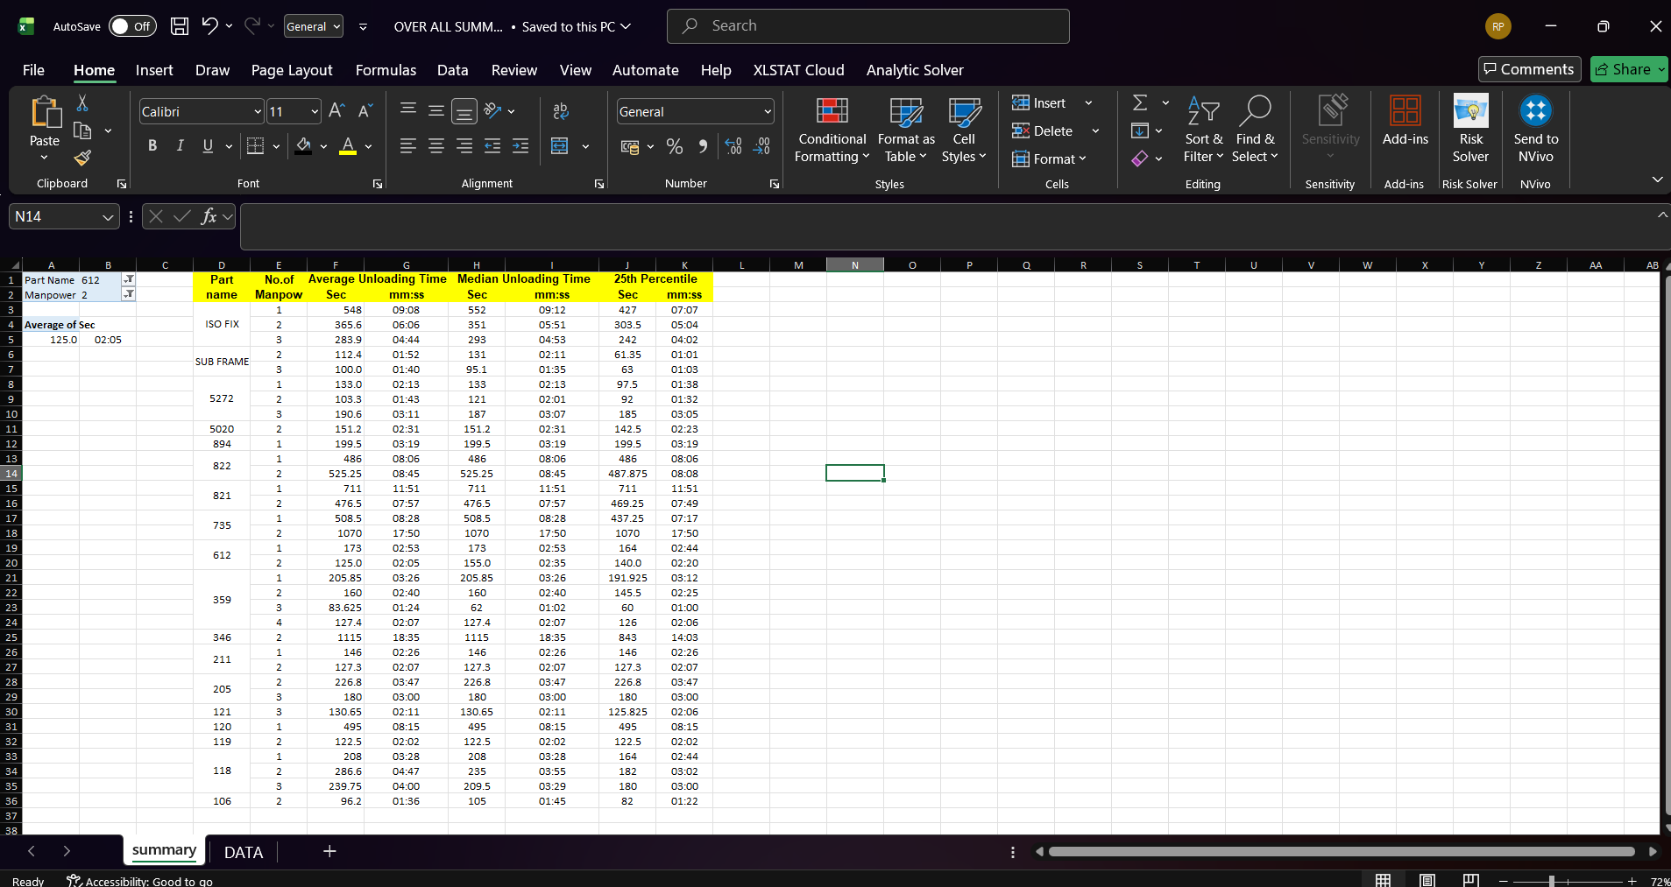
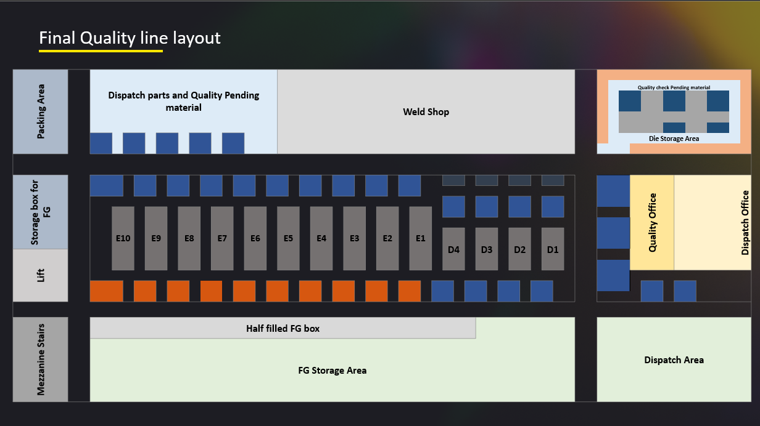
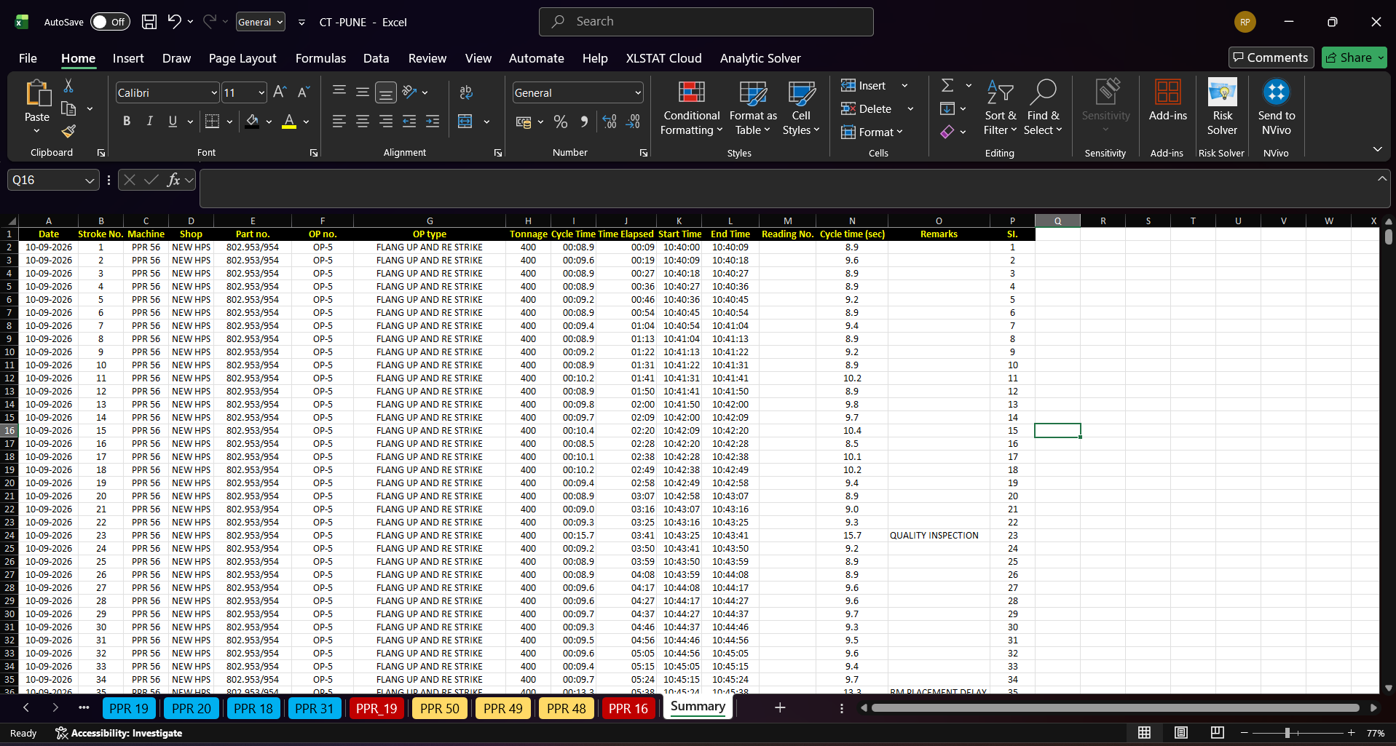
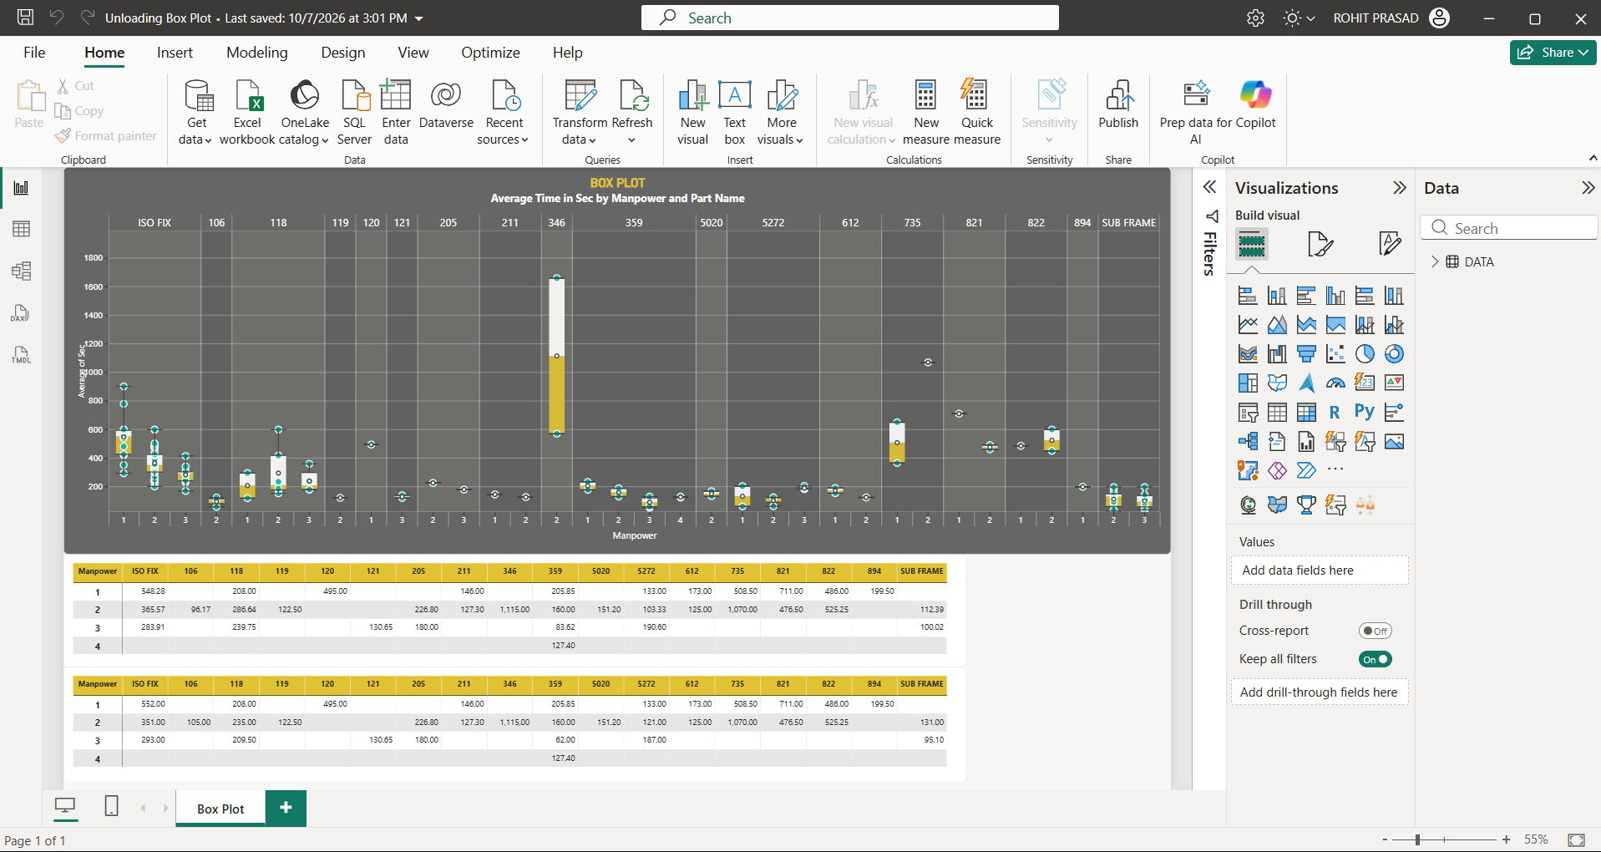
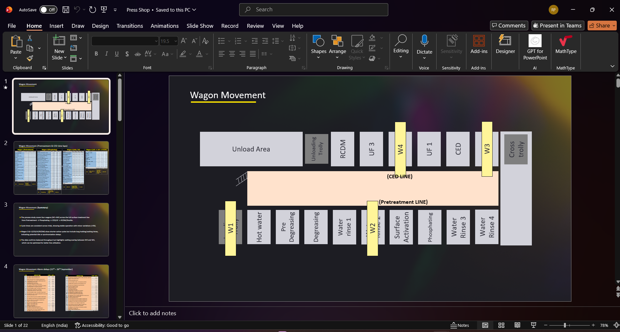
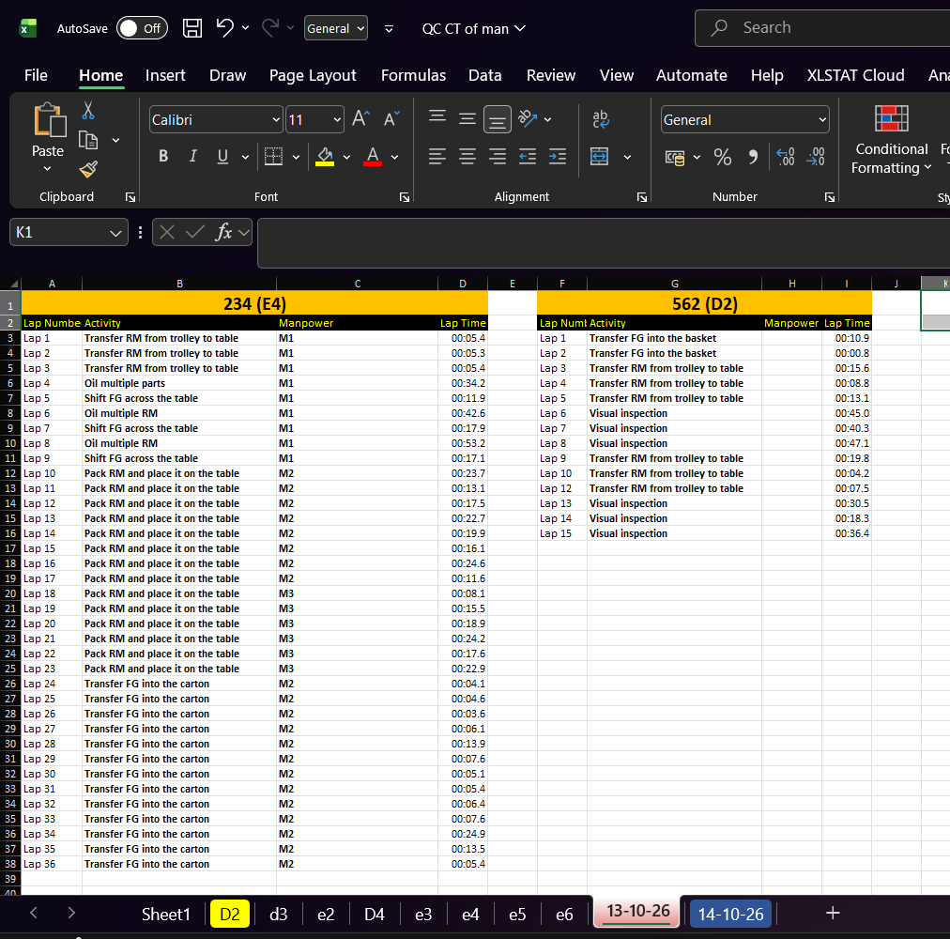
Overall Internship Exposure (SKH Binola) | Key Assignments & Deliverables
Phase 5:Bottleneck identification of M/C &Rework and Rejection analysis
Conducted OEE recalculation considering First Time Right (FTR).
Analysed daily rework trend, model‑wise distribution, and shift‑wise contribution.
Key Findings
Adjusted OEE: 68% vs. MIS 80% → true performance gap.
Rework rising daily; peak ~40K units.
Top 5 models (YED, YHB, YR9, O2, YWB) = ~70% of rework.
Balanced shift contribution → systemic issue, not shift‑specific.
Overall Internship Exposure (SKH Pune) | Key Assignments & Deliverables
1.Manufacturing Process Mapping
3.Paint shop (Unloading area)
4.Final Quality inspection
2.Press shop readings to identify VA/NVA
Press Shop
Inspection
Dispatch
Weld Shop
Raw Material
Paint shop
Innovation & Excellence I Customer Delight I Ownership I Respect, Fairness & Transparency
5

Slide 6
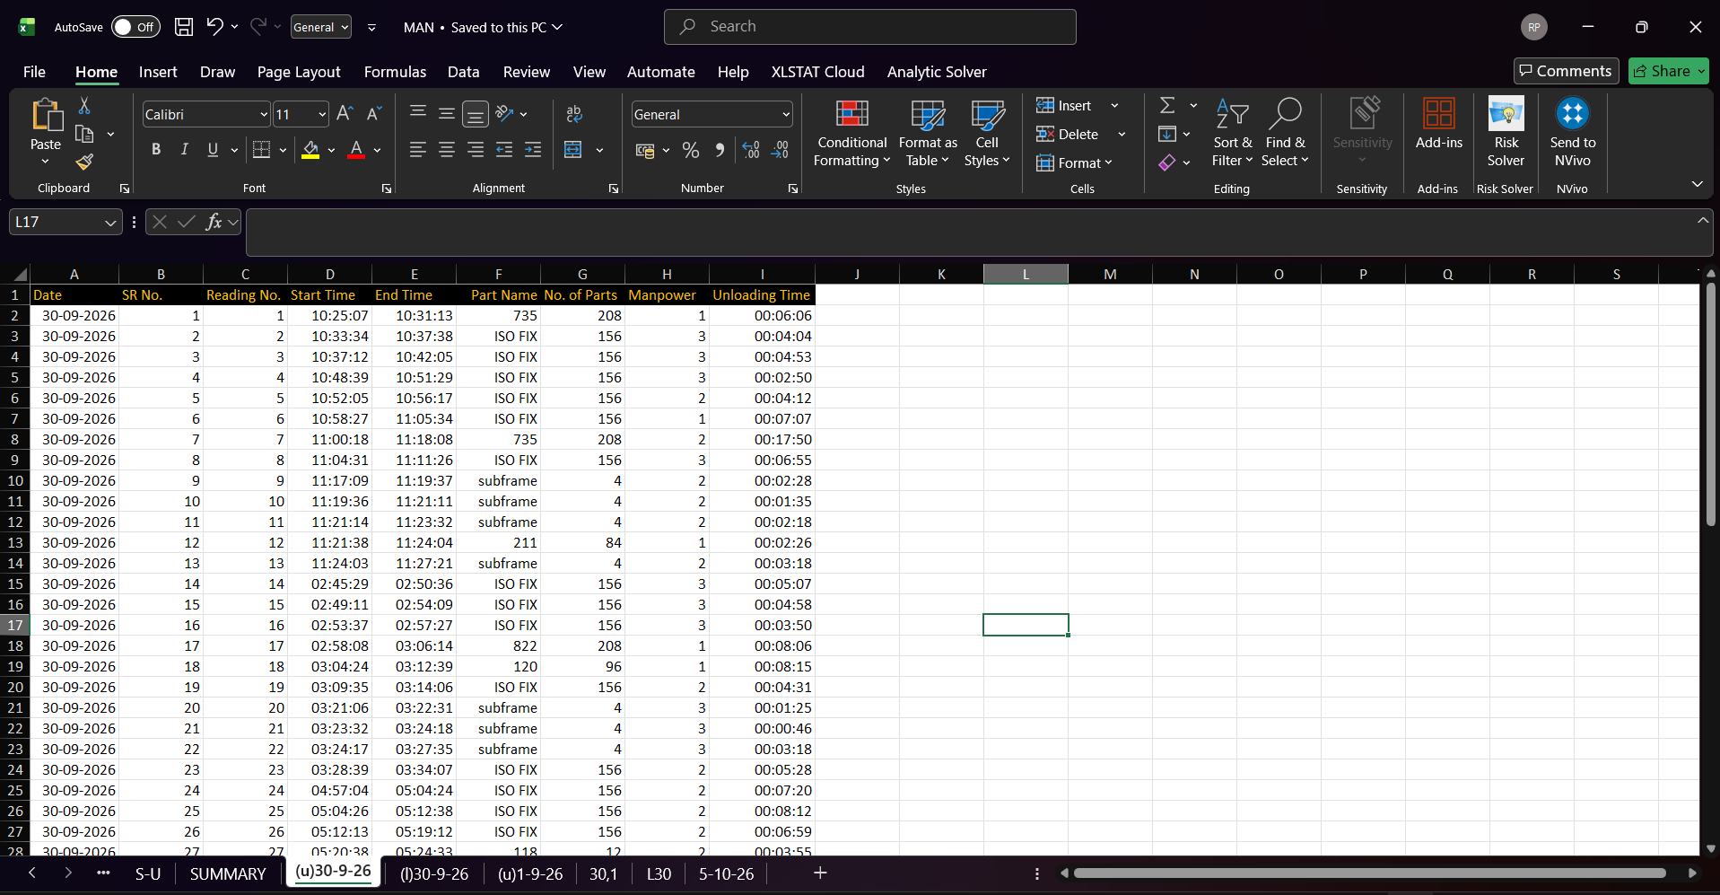
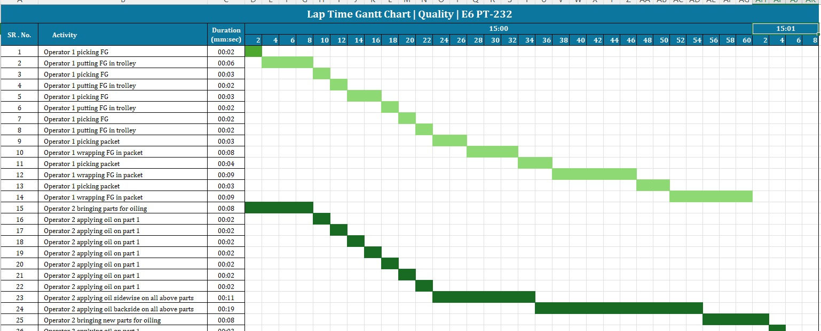
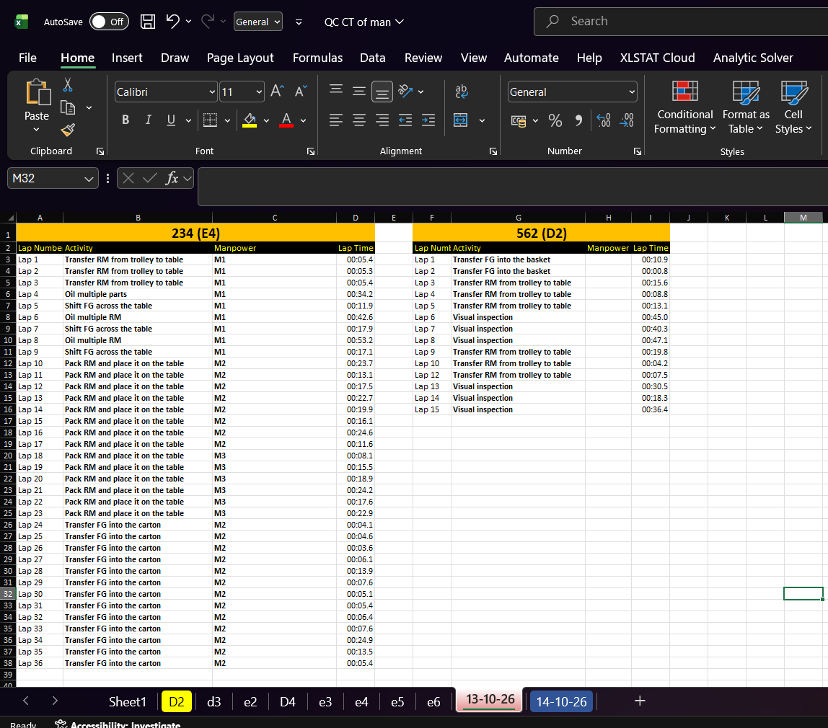
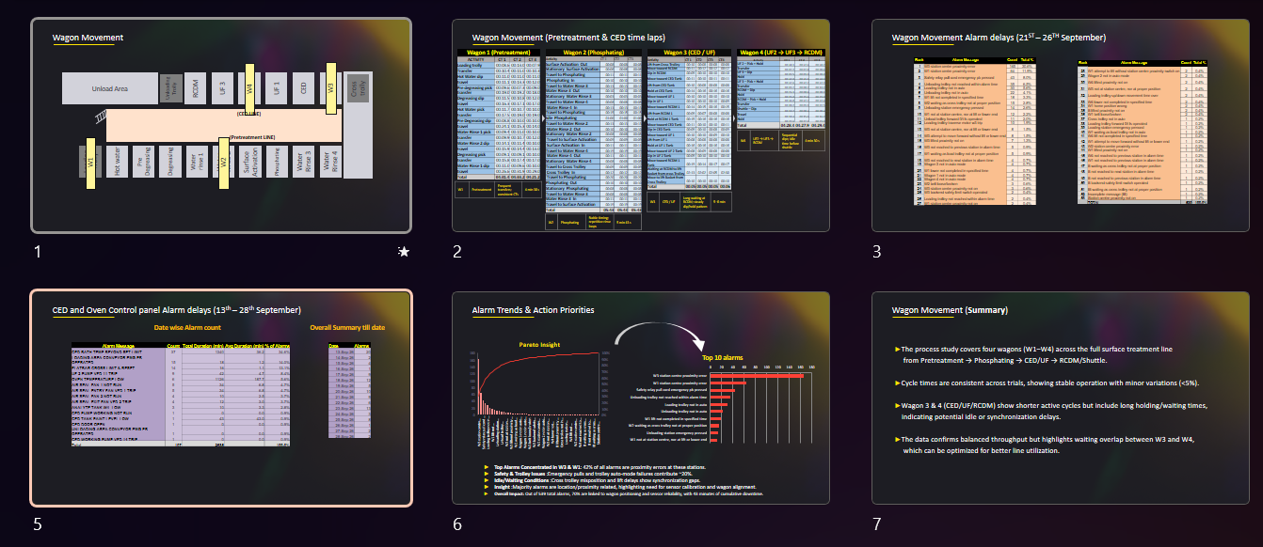

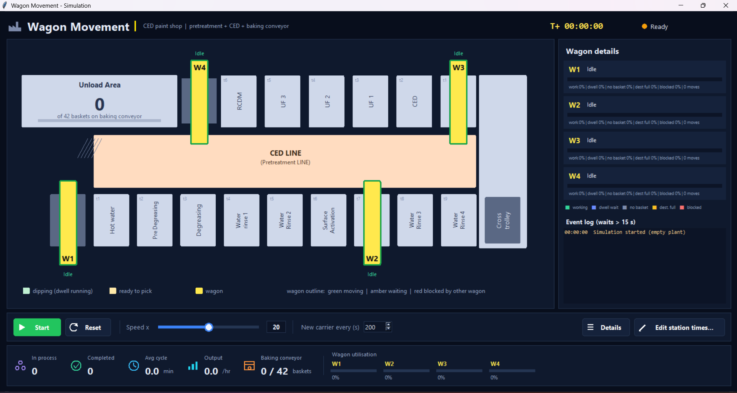
Overall Internship Exposure (SKH Pune) | Key Assignments & Deliverables
Paint shop (Unloading area)
Final Quality inspection
150+
Unloading Baskets
Captured with stopwatch precision across press lines
Data Collection
Wagon Study
Manpower activities and times were recorded and mapped in a Gantt chart.
The study and analysis captured alarm-related delays to identify non-value-added machine stoppages that slow basket movement.
Simulation Based on python and AI
AI was used to support code development for a Python simulation of wagon movement and basket flow through the CED line. The simulation visualizes the process and helps demonstrate where delays and stoppages affect basket movement.
Layout Mapping
The mapped layout provides the basis for As-is mapping will be used for simulating the movement of Trolley through various station.
Innovation & Excellence I Customer Delight I Ownership I Respect, Fairness & Transparency
6

Slide 7
Key Learnings: From Shop-Floor Observation to Improvement
Takeaway:
I learned that meaningful process improvement starts with observing the work, measuring it, and validating what the data shows. Mapping, time studies, and simulation helped me connect shop-floor activity with delays, bottlenecks, and improvement opportunities.
Journey Learnings:
Observe the process
Measure the work
Make the process visible
Connect findings to action
Mapped manufacturing flows and studied activities across the press, paint, and final inspection areas.
Collected cycle-time and changeover data, including 20+ die changeovers, 40+ cycle studies, and 150+ unloading baskets.
Used Gantt charts, layout maps, and a Python simulation developed with AI-assisted coding to show activity sequence, trolley movement, and delays.
Examined alarm-related wagon delays, OEE, bottlenecks, rework, and rejection trends to identify where further investigation could help.
Personal development:
I grew more confident in engaging with shop-floor operations, structuring observations, working with data, and communicating findings visually. I also learned to use digital tools to make process information easier to understand.
Future Action:
Validate improvement ideas on the shop floor and track their impact using clear measures.
Innovation & Excellence I Customer Delight I Ownership I Respect, Fairness & Transparency
7

